Slide 1
customer purchase tracker
Logan Mann and Christopher Schutte

Slide 2

Background Information - I work for Fjällräven on Peal St. - I have a number of regular customers - But we do not have a reliable customer purchase search and analytics software

Slide 3
The Problem - I do not know what my regular customers own - I have no way of recommending products for them - I have no way of easily searching for this information - I have no way of easily entering purchases for these customers

Slide 4
The Solution - A Hash Table based solution that acts as an inventory system and a customer purchase tracker - Use this Hash Table’s information to recommend products to regular customers - Use the quick search of the Hash Table to be able to pull customer information very quickly

Slide 5
The Rational and the Details - Hash Tables were chosen because of their ability to store unique identifiers (email, names, etc…) - Hash Tables for the inventory could be hashed by category and then using linked lists store the products for that category - The customer Hash Table contains a max heap that is used to identify most purchased products, making product recommendation quick and effective

Slide 6
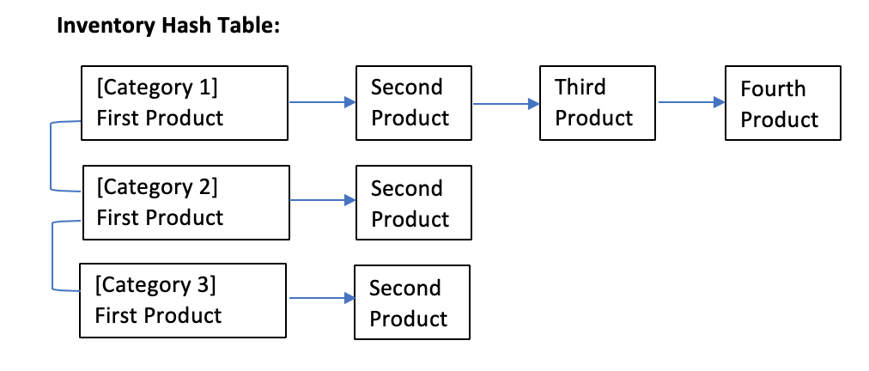
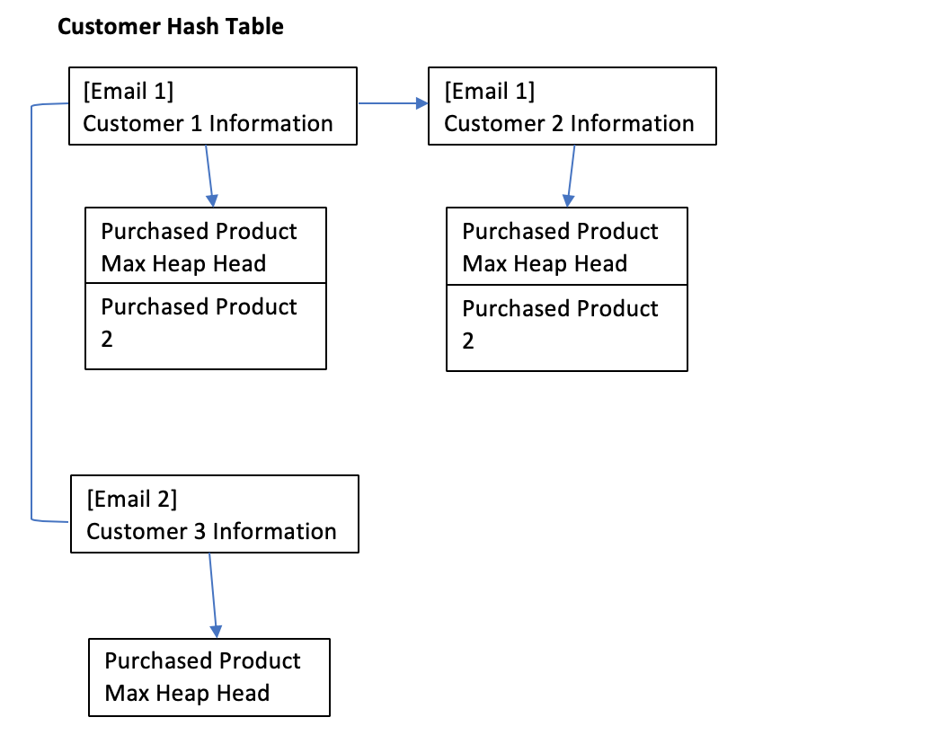
A Quick Diagram

Slide 7
Time for a demo

